Slide 1
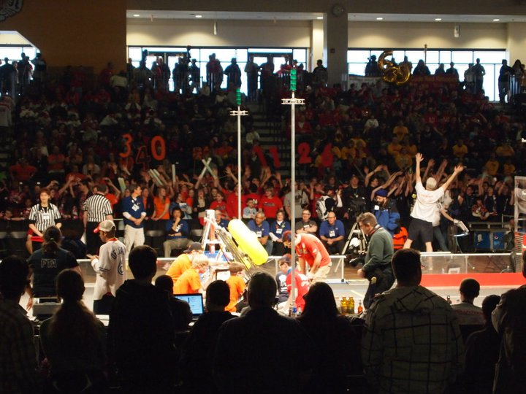
http://www.youtube.com/watch?v=biOfnBxuW84&feature=related&safety_mode=true&persist_safety_mode=1
Notes:
Introductions: Name, position on team, formal team name

Slide 2
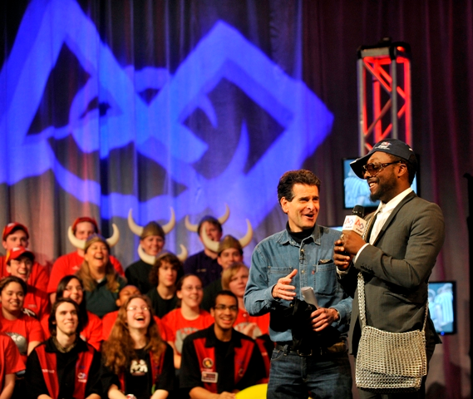
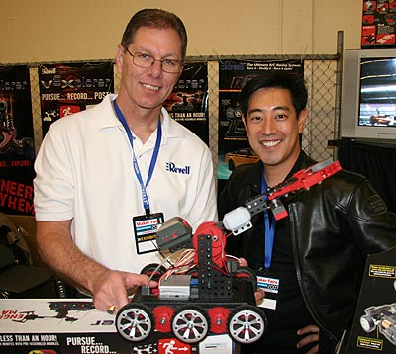
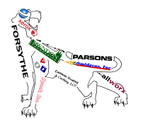
What is FIRST?
Mission
Gracious Professionalism
Myths
Grant Imahara of Mythbusters
Dean Kamen, Founder of FIRST with will.i.am of the Black Eyed Peas
Notes:
FIRST stands for “For Inspiration and Recognition of Science and Technology”
Mission is to promote respect for STEM in the community
Myths: FIRST is uncool. (Everyone wants ipods, cell phones, fast cars- but guess who designs those!)
No girls are involved. (~30% of FIRST is girls, our team is ~15%)
Only for engineers. (We encourage all fields, including marketing, graphic design, PR, etc.)

Slide 3
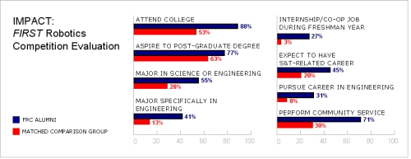
FIRST Students Are…
Notes:
Point out 3 categories: Attend college, major in science or engineering, perform community service

Slide 4
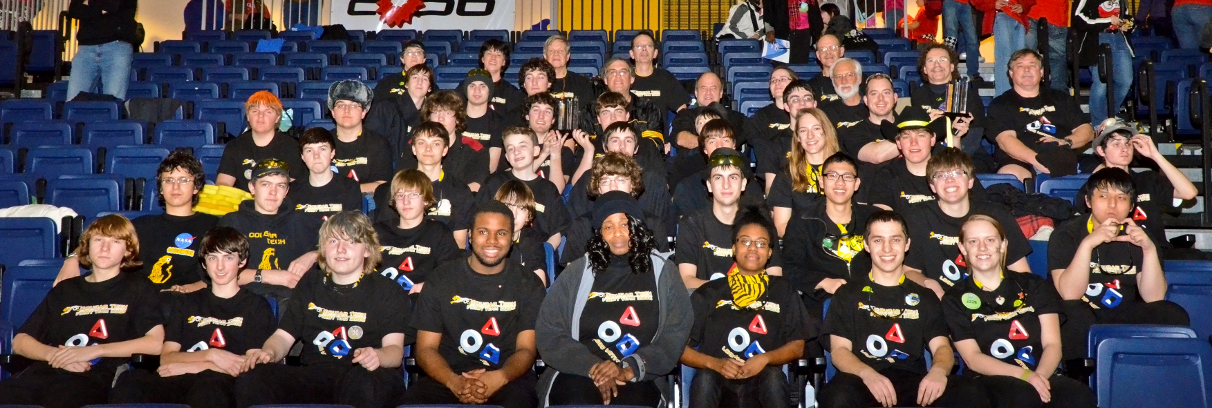
Cougar Tech
History
Build Season
Off Season
Notes:
Started in 2007 with a startup grant from Alstom under the umbrella of the Mendon Foundation. Joined with RH in 2009. Now have about 40 students and 15-20 mentors.
Build season: 6 weeks of planning, systems engineering and building, beginning with Kickoff.
Off season: The “other 46 weeks of the year,” when we do community service, recruitment, and training.

Slide 5
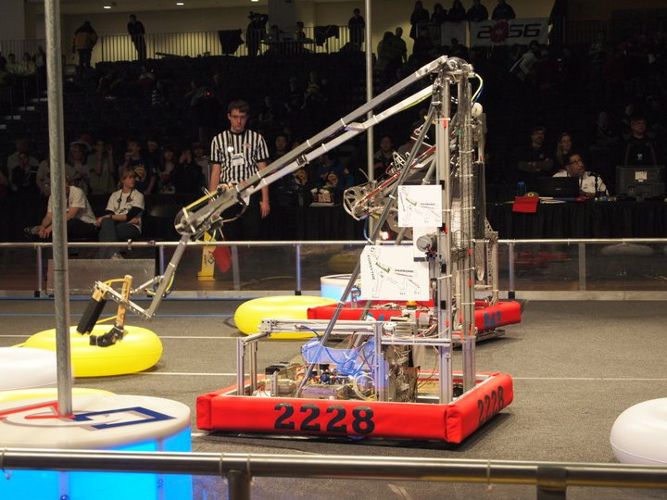
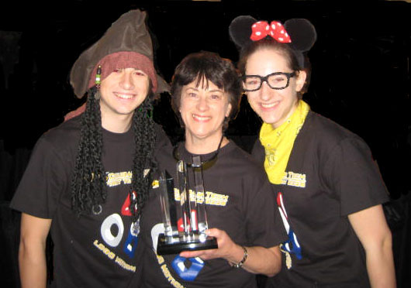
RIT Results
The Game
Awards
Coopertition
Business Plan
Second Place Safety
Notes:
Describe the current/past year’s game.
Last year we won the Cooperition award (RH FTC team built and let other teams borrow their minibots), Business plan (recognizes exceptional entrepreneurship and sustainability), and safety. We also placed 7th overall.

Slide 6
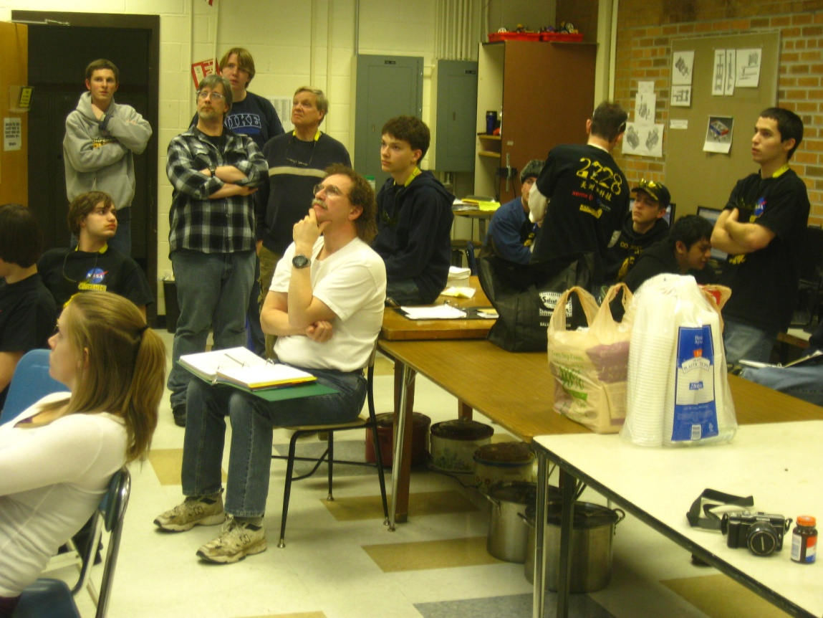
Become a Team Member
Your Involvement
Your Expertise
Your Brain Power
Notes:
We hope you will consider becoming a member of CougarTech. Any knowledge you have will be valuable, whether it is mechanical, artistic or business. Overall, we are looking for dedicated, forward-looking students who are willing to lend us their brain power!

Slide 7
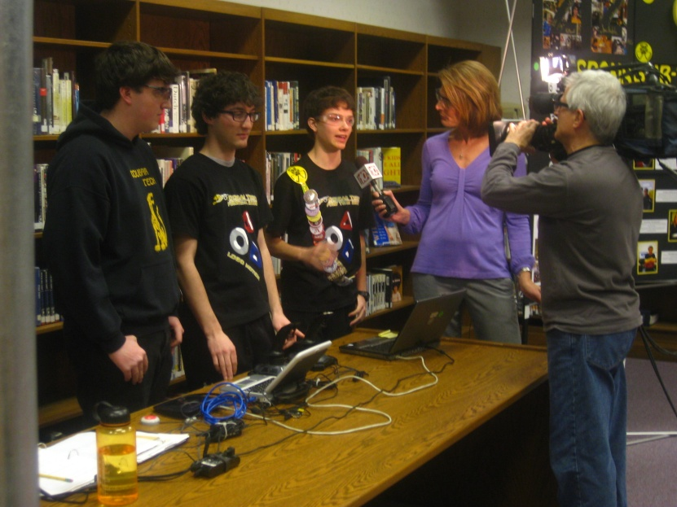
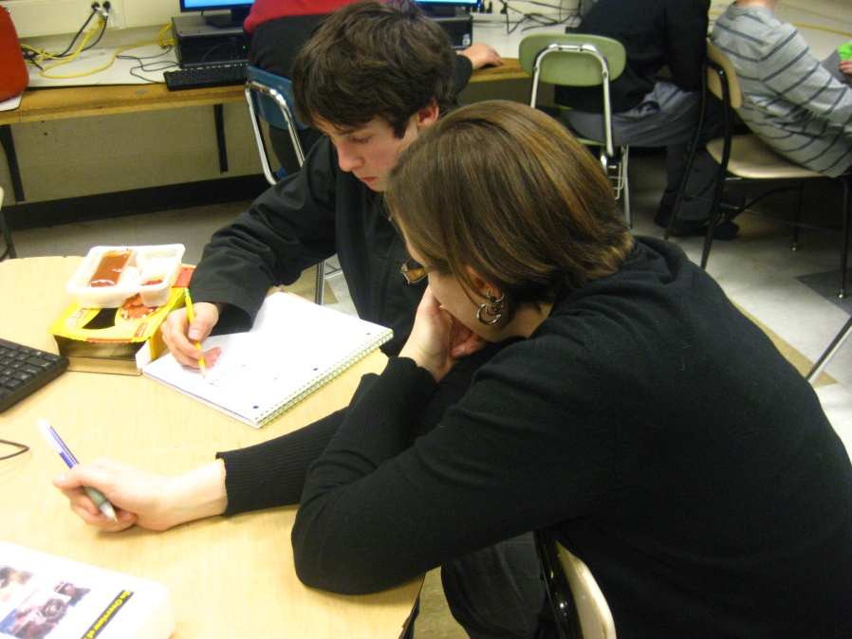
What’s In It For You?
College Majors
Scholarships
Travel
Experience for Life
Notes:
FIRST gives students an insider’s look at a variety of possible careers. Here, you can experience a variety of fields and gain a better perspective of what you want to do in the future. FIRST also offers tons of scholarships for a huge number of colleges and majors. As a member of the team, you’ll be able to travel locally as well as nationally (and sometimes internationally too!). Members gain valuable, hands-on life experience from all of the awesome members that we have. From machining to professional writing, or even giving formal presentations, FIRST is an experience you won’t want to miss!

Slide 8
Q & A
Robin Willick
robbob12393@aol.com

